Slide 1
Synthetic biology falls within the scope of biotechnology, as defined by the Convention on Biological Diversity i.e. “Any technological application that uses biological systems, living organisms, or derivatives thereof, to make or modify products or processes for specific use.”
Synthetic biology methodologies and techniques share various degrees of overlap with those of “modern biotechnology” and, in particular, the “application of in vitro nucleic acid techniques that overcome natural physiological reproductive or recombination barriers and that are not techniques used in traditional breeding and selection, are termed as “living modified organisms” (LMOs).
The term “classic genetic engineering” is used in this document, where necessary, to distinguish organisms resulting uniquely from modern biotechnology techniques from those organisms resulting from synthetic biology techniques combined with modern biotechnology.
Key features of synthetic biology include the “de novo” synthesis of genetic material and an engineering-based approach to develop components, organisms and products.
Synthetic biology builds on modern biotechnology methodologies and techniques such as high throughput DNA technologies and bioinformatics.

Slide 2
The term “synthetic” has been used by geneticists and biologists decades before the term “synthetic biology” was coined, e.g. “synthetic lethality” and “synthetic phenotype”.
In fact, the synthesis of DNA molecules dates back to mid 80s. The current use of the term “synthetic biology” arose in the early 2000s to distinguish this emerging area of science from classic genetic engineering .
In 2004, the Massachusetts Institute of Technology (MIT, USA) hosted “the First International Meeting on Synthetic Biology,” SB1.0.
US Presidential Commission for the Study of Bioethical Issues: Synthetic biology is the name given to an emerging field of research that combines elements of biology, engineering, genetics, chemistry, and computer science. The diverse but related activities that fall under its umbrella rely on chemically synthesized DNA, along with standardized and automatable processes, to create new biochemical systems or organisms with
novel or enhanced characteristics.
The goal of this area of synthetic biology research is the rational design of sequences of DNA to create
biological circuits with predictable, discrete functions, which can then be combined in modular fashion in
various cell hosts. Genetic circuits are seen to function as electronic logic components, like switches and
oscillators.
Synthetic biology that most directly aims to “make biology into an engineering discipline”. This area aims to redesign or rebuild metabolic pathways in order to synthesize a specific molecule from a “cell factory”

Slide 3
Synthetic biology research focuses on the genome as the “causal engine” of the cell , Rather than designing short DNA sequences or engineering specific metabolic pathways, researchers work at the whole-genome
level.
There are two strategies for genome-level engineering: top down and bottom up.
Top-down genome-engineering starts with a whole genome, from which researchers gradually remove
non-essential genes to trim it down to the smallest possible genome size at which the cell can continue
to function as desired.
Bottom-up genome-engineering aims to build functional genomes from fragments of synthesized DNA; it is also referred to as “synthetic genomics”.
Protocell construction: Like the search for a minimal genome, researchers seeking to create a protocell are driven to design for less complexity at the cellular rather than genome level. Protocells have been described as “models of artificial cells that have some properties of living systems but are not yet fully alive” .
For protocell to be created, the simplest possible components to sustain reproduction, self-maintenance and evolution.
Three critical things are required : a container or membrane to confine reactions; a metabolism so that energy can be stored; and molecules to carry information in order to adapt to changing environments

Slide 4
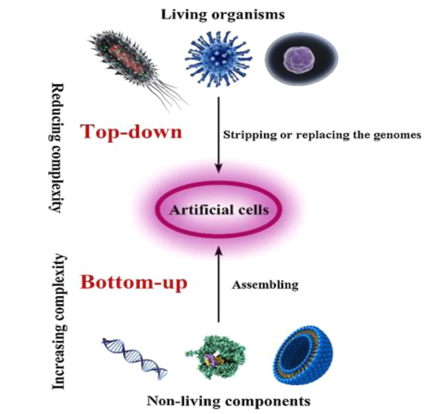
The top-down approach aims to shorten the genome by identifying the lowest number of genes needed in laboratory conditions to survive.
It develops a genetically stable, metabolically
robust platform with low energy to carry out tasks
and generate less unwanted waste products.
In this approach researchers identify and isolate specific
chemical processes performed easily by metabolically
active bacteria.
The genes responsible for this chemical process are sequenced or synthesized and inserted into yeast cell.
Then, highly productive modified yeast cells will be produced and these modified yeast cells perform new or enhanced chemical processes and functions. This is done either by stripping or replacing the genomes.
Thus, only a small number of cells is enough to fulfil a limited set of physiological functions. However, most of these cells will have low environmental persistence and will only survive under specific laboratory conditions

Slide 5
The bottom-up method is to create new kinds of self-reproducing minimal cellular life. It increases the complexity of the biological system by assembling various non-living components. In other words, a bottom-up approach can cause the engineering of novel minimal biological systems with desired properties.
It uses raw materials, which are not necessarily natural (non-living) but mimic the properties of natural molecules.
Based on biological knowledge, life can be chemically constructed with suitable intermediate organisms. Recent advances have resulted in reforming the organisms with entire synthetic genomes with DNA synthesis and computation.
The protocell is the final bottom-up creation, which mimics certain functions of cells. It is a polypeptide-like or membrane-like structure that separates the inner and the outer world . protocell systems are chem-
ical systems which are designed to imitate cell behaviour and emerging properties via their component interactions.
Protocells have potential biotechnological applications. protocells could be used for synthesis and processing of biotechnological products with high efficiency in mass scale and reduced cost of production.

Slide 6
Research is aiming to achieve compartmentalization through approaches such as lipid-based vesicles, inorganic nanoparticle based membrane vesicles, and membrane-free peptide/ nucleotide droplet formation.
Cell-free approaches attempt to eliminate cells altogether to provide a more controllable biochemical context for synthetic biology devices.
Potential protocell applications include the development of smart “paints” that fix carbon dioxide
into inorganic carbonate, chemical agents that convert environmental waste toxins into harmless
chemicals, and alternative methods of producing biofuels
Xenobiology (also known as chemical synthetic biology) is the study of unusual life forms, based on biochemistry that is not found in nature.
Xenobiology aims to alter the “biochemical building blocks of life,” such as by modifying genetic information to produce xenonucleic acids (XNA) or by producing novel proteins . One approach to producing XNA is to modify the nucleotide bases of DNA beyond A, G, C, and T, incorporating alternative synthetic nucleotides into DNA.

Slide 7
In synthetic biology, biological cells and processes are dismantled and reassembled to make
novel systems that do useful things.
Designs are encoded by deoxyribonucleic acid (DNA); DNA makes biological (bio-)parts; bioparts are combined to make devices; devices are built into biological systems.
Computers are used at all stages of the Design–Build–Test–Learn cycle, from mathematical modelling through to the use of robots for the automation of assembly and experimentation.
Synthetic biology applies engineering principles of standardization, modularity, and abstraction, enabling fast prototyping and the ready exchange of designs between synthetic biologists working around the world.
Like toy building blocks, compatible modular designs enable bioparts to be combined and optimised easily. Synthetic biology seeks to use natural parts of biological systems (like DNA fragments or protein biobricks) to create assemblies that do things that are not done by natural biology, such as digital computation or manufacture of specialty chemicals”. Among chemists, by contrast, “synthetic biology seeks to use unnatural molecular parts to do things that are done by natural biology”.

Slide 8
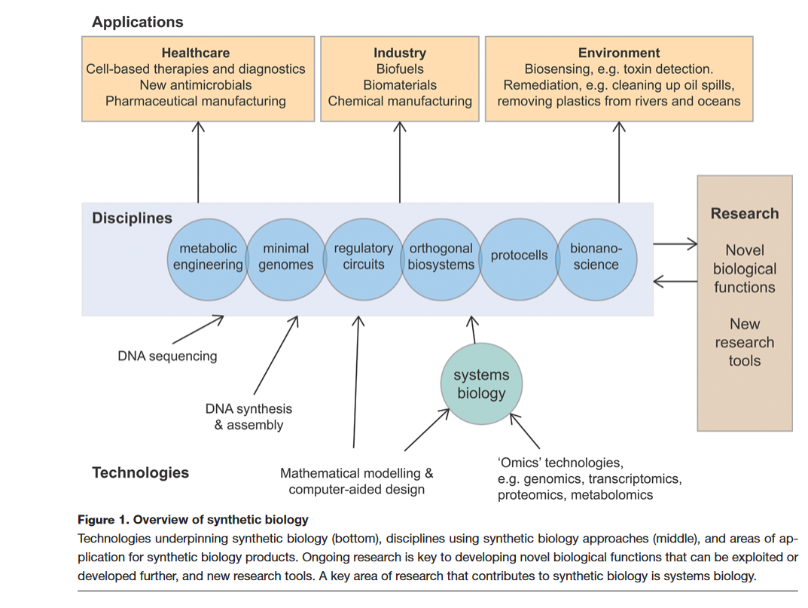
Synthetic biology has applications in healthcare, industry, and the environment. Several disciplines use the synthetic biology approach, including metabolic engineering, minimal genomes, regulatory circuits, and orthogonal biosystems, and
ongoing research is essential in all disciplines to test new ideas and develop new products and research tools.

Slide 9
Application of synthetic Biology (SB)
SB is a technology applied in all sectors, such as agriculture, food, health, chemical and industrial production.
Health Applications
SB offers potential benefits for immunoassay development, diagnosis, drug screening, new antibiotics generation, drug production and sensor-effector therapeutic development.
Diagnosis of communicable and non-communicable diseases including cancer, coro-
nary artery disease, ebola, Zika, tuberculosis, malaria, HIV, SARS-coV-2, routine blood test quantification,
and water quality monitoring has been successfully performed using SB.
Agricultural applications
Synthetic biology also delivers major outcomes for agriculture . It can increase crop-based sustainable
fuel production. SB will generate products to reduce farm waste and provide methods to convert them into methane and other economically significant products.
Specifically, synthetic biology promises to deliver benefits that increase productivity and sustainability across primary industries, underpinning the industry’s prosperity in the face of global challenges.
Research institutes and companies work on microbes to optimize their synthetic metabolic pathways, biofuel
production, enzyme production and the development of engineered microbes. engineered cyanobacterial
organisms and eukaryotic alga could be used for making valuable industrial compounds like biofuels and
other chemicals

Slide 10
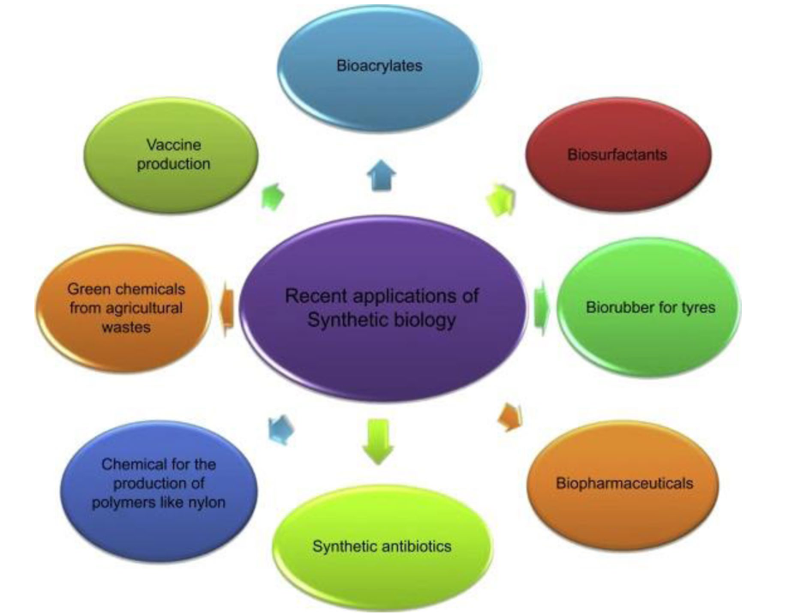
Environmental applications
SB’s contributions to environmental protection include biosensing systems that convert environmental signals into unique cellular events.
Microorganisms are engineered
to remediate a few of the most haz-
ardous environmental pollutants
Products from synthetic biology
Products are categorized below based on the stage at which synthetic biology organisms are used and the products replaced by the synthetic biology versions. The majority of current and near- term commercial and industrial applications of synthetic biology engineer microbes that replicate naturally-occurring or petroleum-based molecules for pharmaceuticals, fuels, chemicals, flavorings and fragrances.

Slide 11
In healthcare, synthetic biology can be used to improve diagnosis of disease, and it can be used to make new
treatments. An important part of developing new pharmaceuticals is making medicines with fewer side effects.
Side effects or ‘off-target’ effects tend to occur if a drug binds to lots of different cells and proteins in the body, despite only a small number of these binding sites being necessary for its disease or infection-fighting property.
Synthetic biology can be used to make treatments directed only towards the site of disease, treating the disease itself without causing any negative effects.
Many pharmaceuticals are naturally made by plants. These include pain killers, morphine (an opioid) from poppies and salicylic acid (a plant hormone and precursor to aspirin) from willow bark, but it is not always easy to produce a high yield of these compounds.
Synthetic biology can be used to engineer yeast to produce medicines more efficiently, on a large scale, making them also cheap to produce the first drug to be produced in this way was artemisinin, a treatment for malaria.

Slide 12
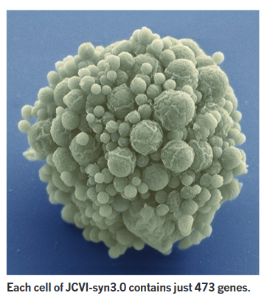
Synthetic life / artificial life and Craig Venter
Genomics entrepreneur Craig Venter has created a synthetic cell that contains the smallest genome of any known, inde-
pendent organism. Functioning with 473 genes, The cell is a milestone in his team’s 20-year quest to reduce life to its bare essentials and, by extension, to design life from scratch.
Venter, who has co-founded a company that seeks to harness synthetic cells for making industrial products, says that the creation of customized cells to make drugs, fuels and other products.
Powerful ‘gene-editing’ techniques, which enable relatively easy and selective tinkering with genomes.
Unlike the first synthetic cells made in 2010, in which Venter’s team at the J. Craig Venter Institute in La Jolla, California, copied an existing bacterial genome and transplanted it into another cell, the genome of the minimal cells is like nothing in nature.
Who are the parents of Mycoplasma mycoides JCVI-syn1.0?
The Venter team created a synthetic bacterium, Mycoplasma mycoi-
des JCVI-syn1.0, whose genome sequence is composed of the genome sequence of M. mycoides, a yeast cloning vector, and some artificial DNA sequence.
Dr. Craig Venter stated that his team had created “the first self-replicating species we’ve had on the planet whose parent is a computer.”

